Slide 1
Multimedia System and Virtual Environment
CSE – 310
Multimedia File System
Dept. of Computer Science and Engineering, University of Rajshahi

Slide 2
Outline
Multimedia File Systems
Near Video on Demand
File Placement
Disk Scheduling for Multimedia
Dept. of Computer Science and Engineering, University of Rajshahi

Slide 3
Multimedia File Systems
Traditional file systems perform an open, several reads and close at the end
During read operations, processes wait until I/O is finished but timing is not all that important. The data eventually comes.
That is, the user pulls the data in one block at a time by repeatedly calling read calls to get one block after the other
File servers of this type are often called pull servers (user pulls the data)

Slide 4
Multimedia File Systems
For multimedia,
read calls must be at fairly specified times
and
the video server must be able to supply data blocks without a delay
Multimedia file servers, after a start call, begin sending out frames at the required rate. It is up to the user to handle them.
File servers of this nature are called push servers because they push data at the user.

Slide 5
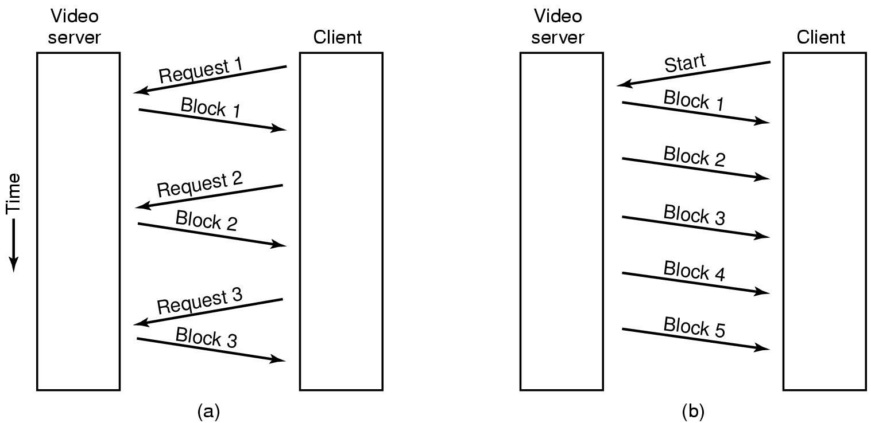
Multimedia File System Paradigms
Pull and Push Servers

Slide 6
File Placement
Multimedia files
Are very large
Written once but read many times
Accessed sequentialy

Slide 7
Contiguous File
A contiguous file in a computer is one that is placed on a storage drive in sequential. This is generally regarded as advantageous because it results in better performance by decreasing the amount of time it takes the computer to read the data (compared to when a single file is spread over a larger portion of the drive and not located in contiguous sectors).

Slide 8
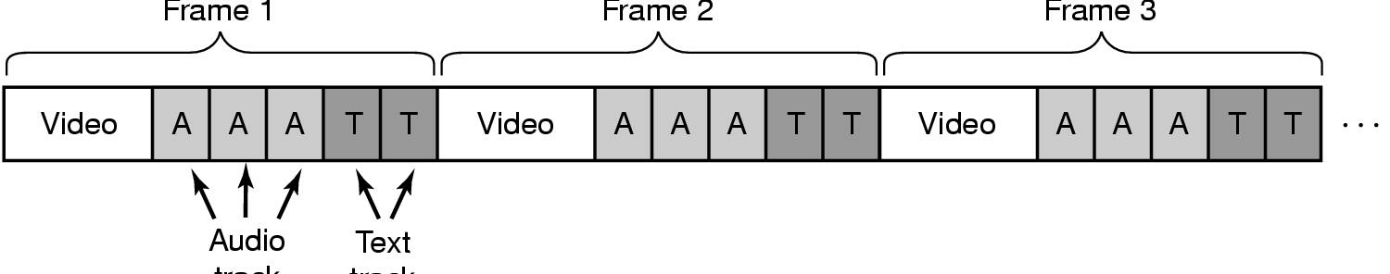
Contiguous Movie Storage
Frame 1
Frame 2
Frame 3
Audio Frame
Text Frame
Video, audio, text in single contiguous file per movie instead of separate files for each component
Read one frame in one disk operation and transmit only relevant parts to the user
This organization is not efficient when random access is needed or in video servers with multiple concurrent output streams

Slide 9
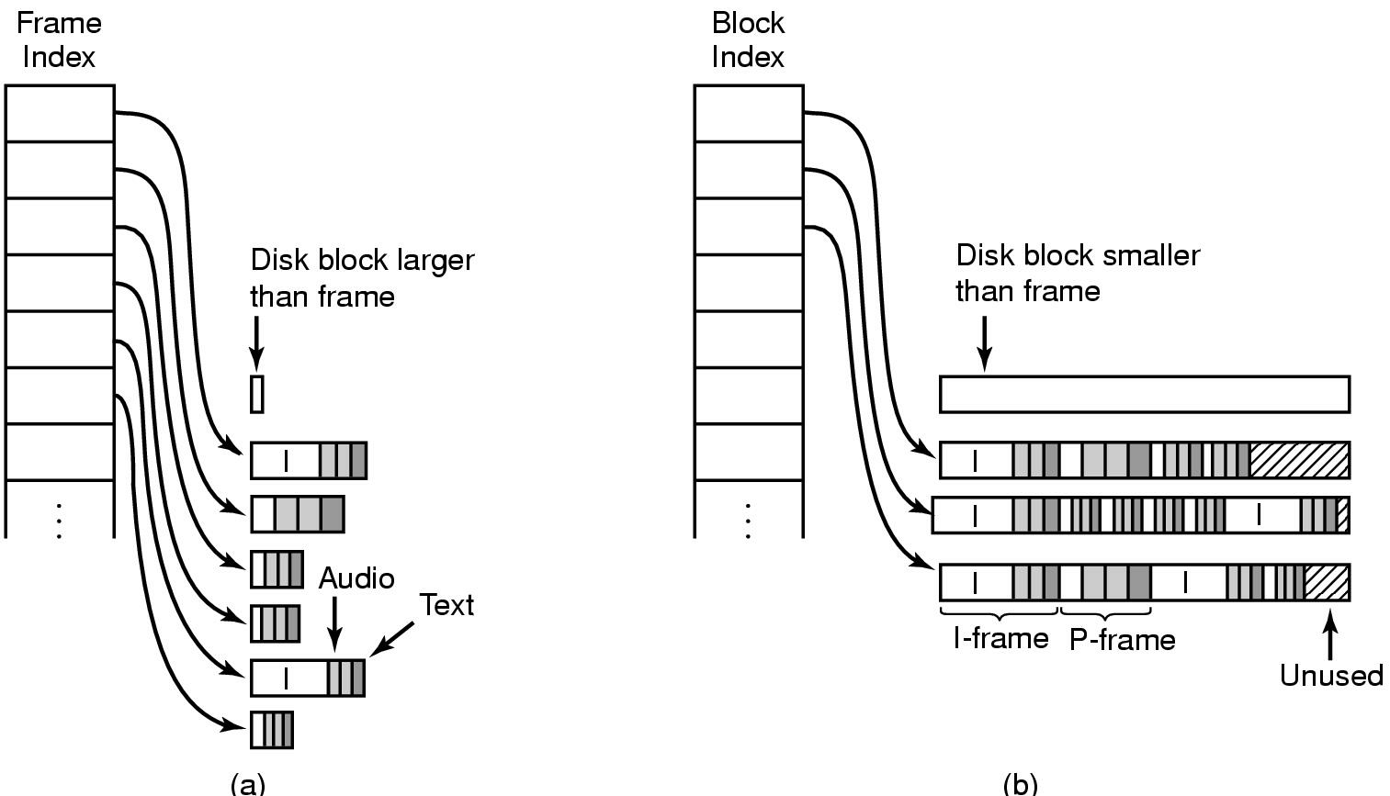
Noncontiguous Movie Storage
small
larger
Small disk blocks -
a frame index for the whole movie
each index points to one frame data (variable frame size)
Large disk blocks
multiple frames in one block (constant block size)
a block index for the whole movie

Slide 10
Trade-offs between small, large blocks
Frame index
heavier RAM usage during movie play
little disk wastage
Block index (no splitting frames over blocks)
low RAM usage
major disk wastage
Block index (splitting frames over blocks allowed)
low RAM usage
no disk wastage
extra seeks

Slide 11
Near Video on Demand
Having k users getting the same movie puts essentially the same load on the server as having them getting k different movies.
Since viewers want to view at arbitrary times one movie stream can not be shared.
Tell users that movies start on the hour and every (for example) 5 minutes thereafter. Thus if a user wants to see a movie at 8:02, he will have to wait until 8:05
A 2-hour movie starting at every 5 minutes need 24 (120/5) streams regardless the number of customers.
Viewers starting at the same starting time share the stream

Slide 12
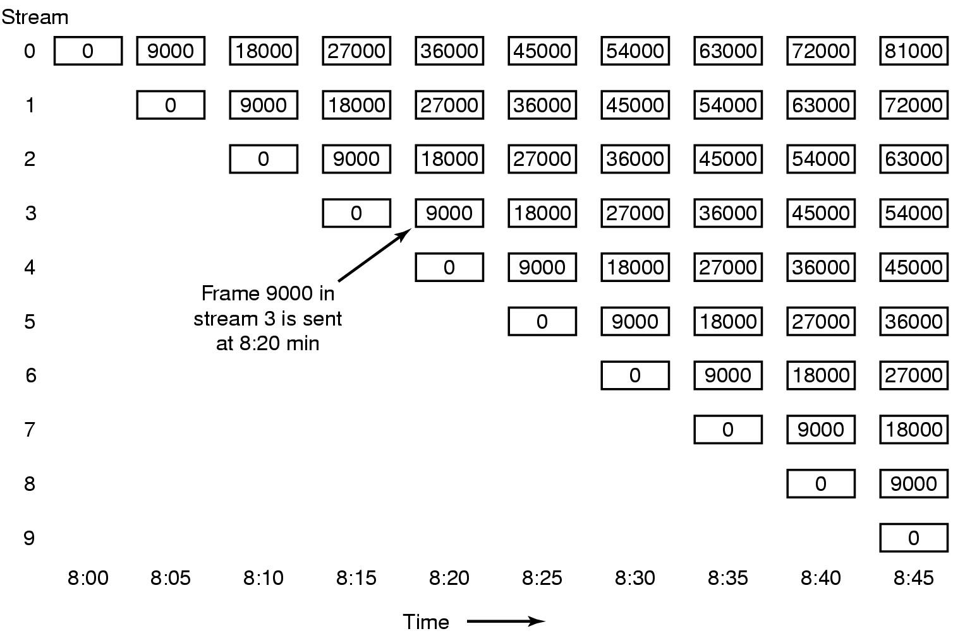
Near Video on Demand
New stream starting at regular intervals (in every 5 minutes for a 2-hour movie)

Slide 13
Placing Files for Near Video on Demand
30 frames/sec with a new stream starting every 5 minutes
Frame sets of 24 frames are concatenated and written to the disk as a single record. They can also be read back on a single read.
Frames needed for all 24 streams at that time are in track 1 as a single record which can be read in one read operation.

Slide 14
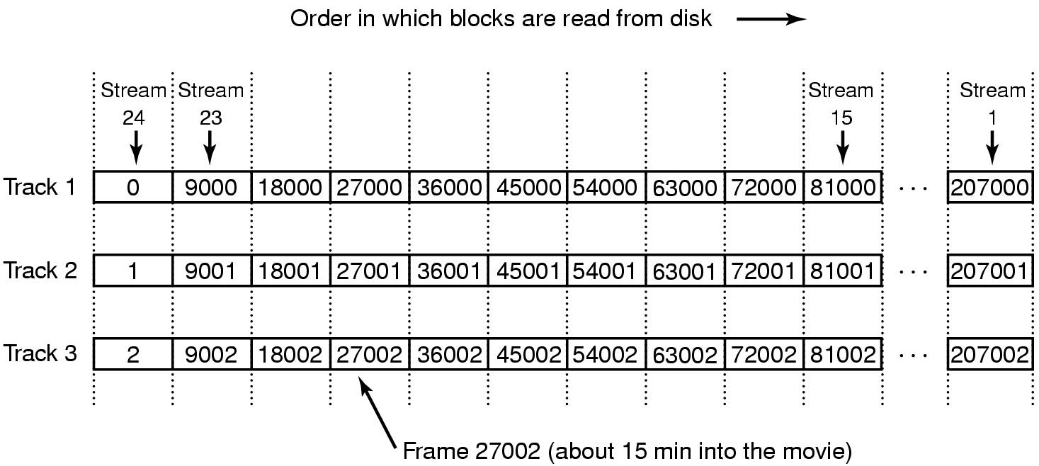
Placing Files for Near Video on Demand
Double buffering is used (playback from one buffer while reading the next 24 frames from the next track)

Slide 15
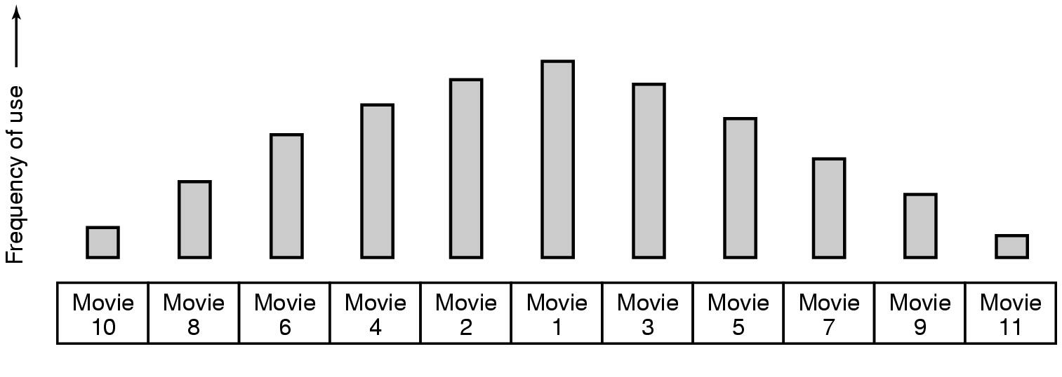
Placing Multiple files on a Single Disk
Organize pipe distribution of files on server
most popular movie in middle of disk
next most popular either on either side, etc.
This strategy is based on statistical analysis of popularity
For a 1000 movie server, top 5 movies represent a total probability of .307, which means that the disk arm will stay in the cylinders allocated to the top five movies about 30% of the time

Slide 16
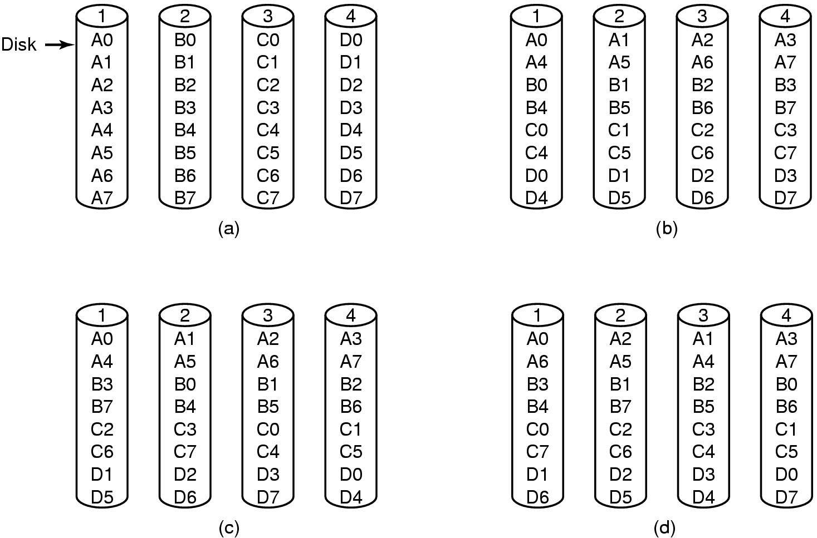
Placing Files on Multiple Disks
Organize multimedia files on multiple disks to balance the load on disks
(a) No striping – one disk holds all frames of a movie - popular films may cause a strain on the relevant hard disk
(b) Same striping pattern for all files – all movies start from the same disk
(c) Staggered striping
(d) Random striping
This organization is not a RAID (redundant array of independent disks)

Slide 17
File Caching
Most movies are stored on DVD or tape to save disk space
copy to disk when needed
results in large startup time
keep most popular movies on disk
Can keep first few minutes of all movies on disk
start movie from this while remainder is fetched

Slide 18
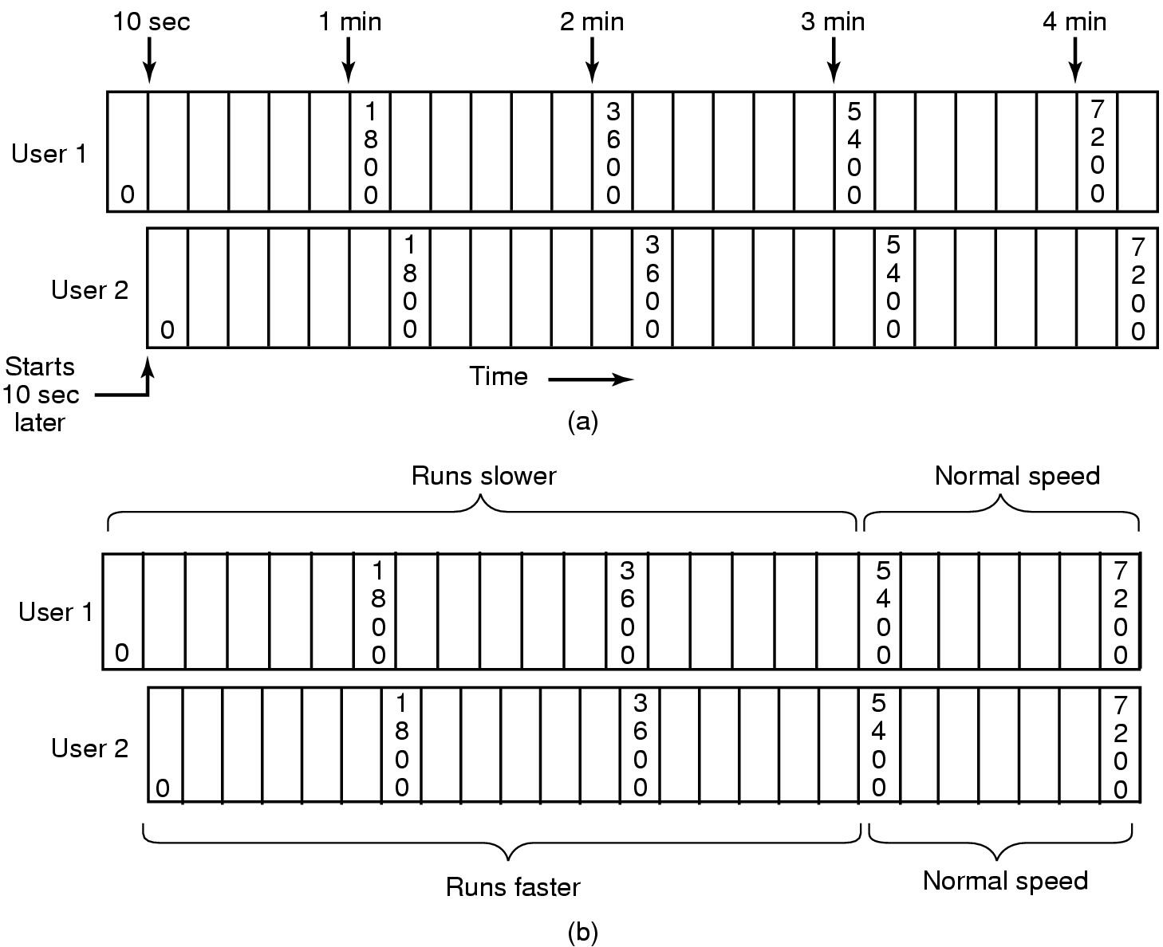
Caching
Block Caching
Two users, same movie 10 sec out of sync – keep the blocks in cache, but this wastes memory
Merging two streams into one by running the first movie a bit slower and the other a bit faster for a while

Slide 19
Disk Scheduling for Multimedia
Traditional OS
requests for disk blocks is unpredictable
one-block read ahead for each file to increase performance
other than that, wait for requests to come in and process them on demand
Multimedia OS
each active stream puts a well defined load on the system that is highly predictable (for PAL, a frame is needed every 40 msec)

Slide 20
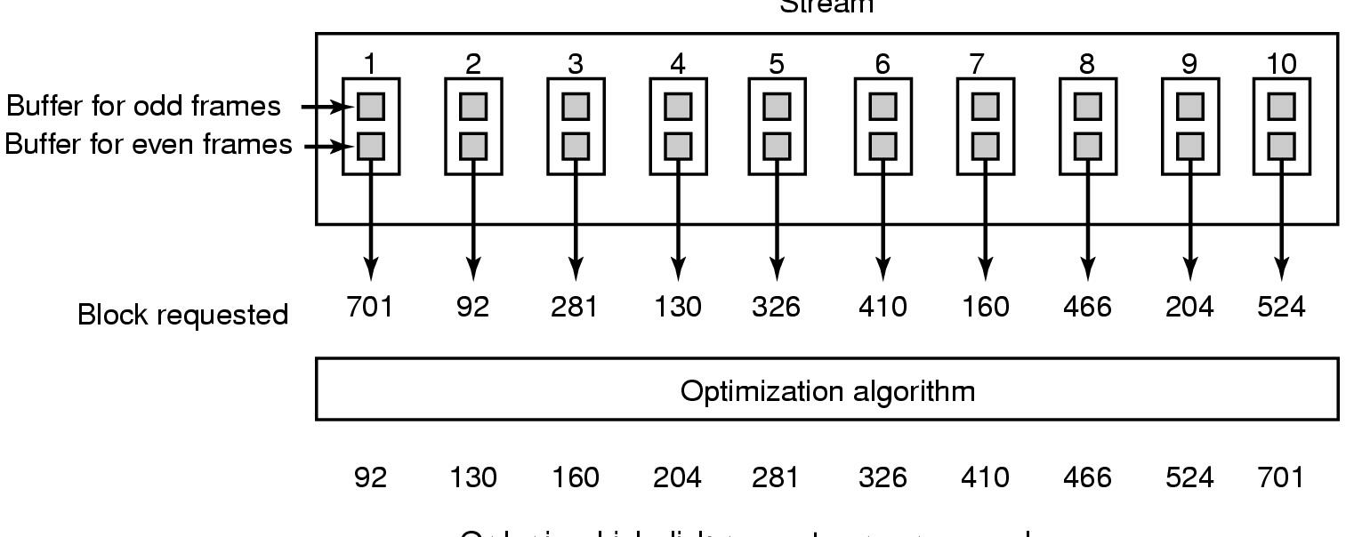
Static Disk Scheduling for MM
Stream
Order in which disk requests are processed →
Time is divided into rounds, where a round time is the frame time (40 msec for PAL)
In one round, each movie asks for one frame (no requests till the the next round)
Sort the requests in the optimal way – probably in cylinder order
Use double buffering in the server
Works well if all streams have the same properties (frame rate, resolution etc.)

Slide 21
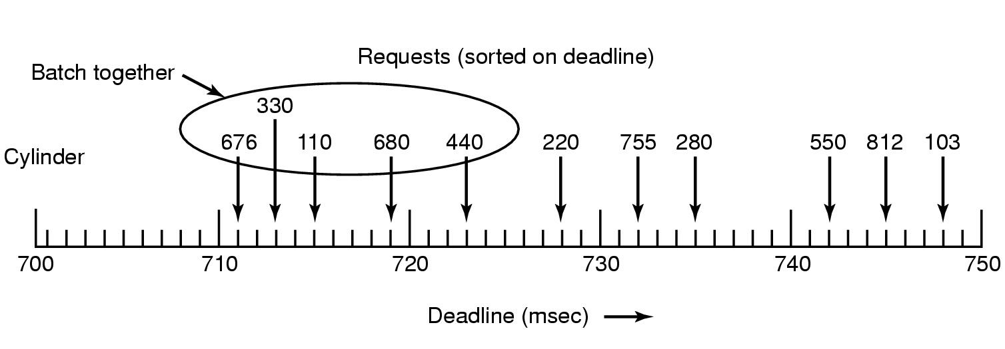
Dynamic Disk Scheduling
Dynamic scheduling is needed for movies with different properties
Scan-EDF algorithm uses deadlines & cylinder numbers for scheduling
Collect requests whose deadlines are relatively close together into batches and process these in cylinder order using the elevator algorithm

Slide 22
Dynamic Disk Scheduling
The elevator algorithm (also SCAN) is a disk scheduling algorithm to determine the motion of the disk's arm and head in servicing read and write requests.
This algorithm is named after the behavior of a building elevator, where the elevator continues to travel in its current direction (up or down) until empty, stopping only to let individuals off or to pick up new individuals heading in the same direction.

